Slide 1


National Dementia Care Collaborative
Getting to Yes for Launch: Overcoming Challenges to Implement Comprehensive Dementia Care
Provider Engagement and Marketing Strategies
for Patient Recruitment
September 25, 2025

Slide 2

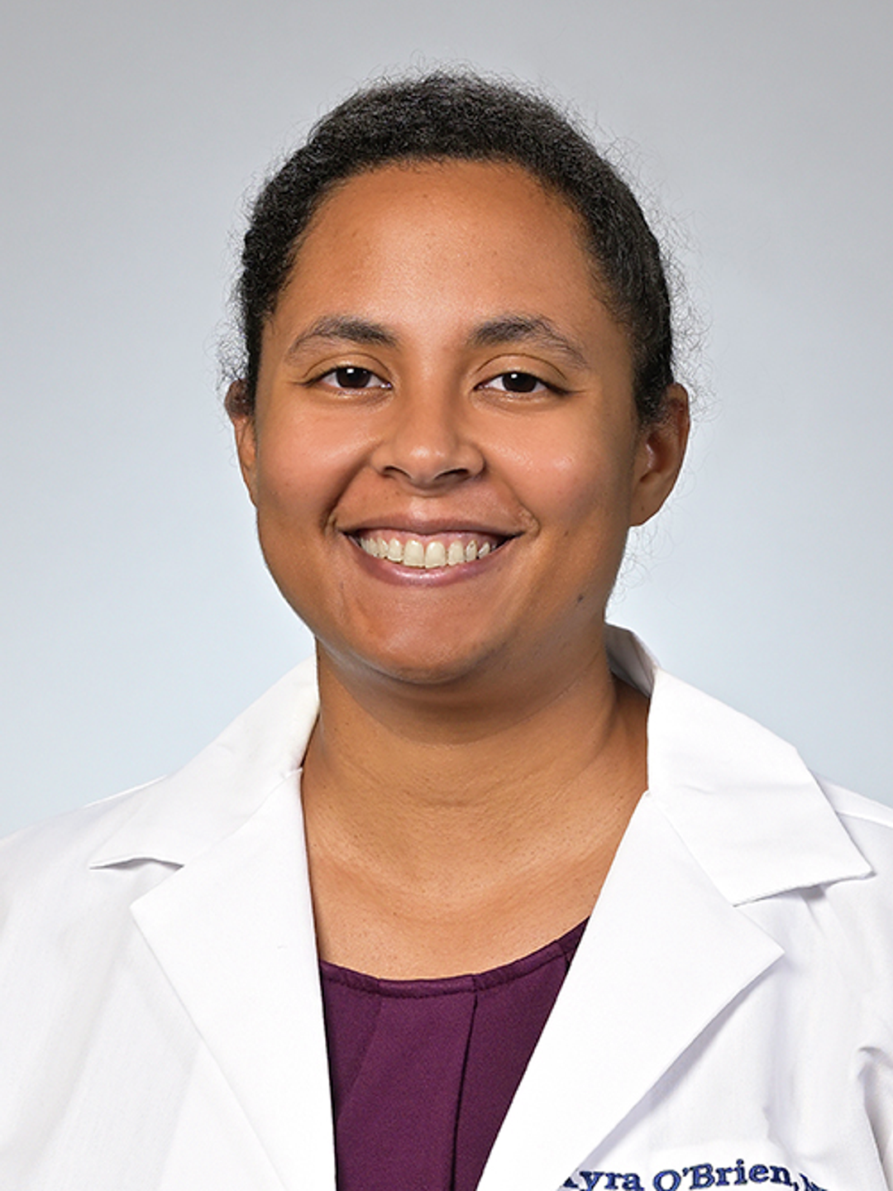
Barak Gaster, MD
University of Washington
Kyra O’Brien, MD, MS
University of Pennsylvania
Dementia expert and primary care physician
Leadership committee selected to develop the CDC’s National Healthy Brain Roadmap
Director, Cognition in Primary Care
Assistant professor of Neurology
Penn Memory Center
Medical Director, Penn Medicine GUIDE program

Slide 3
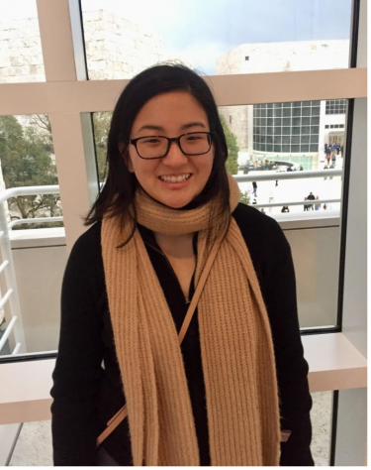




GUIDE + Primary Care
Getting to Yes
Barak Gaster, MD General Internal Medicine
University of Washington

Slide 4

The Realities of Primary Care
Many many competing problems – never one problem
Quick quick quick visit slots
Limited medical assistant staff to assist
Between visit care is an enormous challenge
Often: close to no social work or nursing support
Notes:
Alright so now you're ready to put it together
you're going to take the MoCA result and put it
together with the family input to make an assessment
for example let's say that the MoCA score is
intermediately-low say in the 18 to 25 range,
out of a possible score of 30
and let's say that the observer who's with them
IS reporting some worrisome changes
but they are still fully independent in their activities
of daily living. - that is they’re still able to dress
themselves cook and clean. That is a diagnosis
of mild cognitive impairment and we'll talk more in
a moment about what that diagnosis means

Slide 5

Opportunities! GUIDE + primary care
GUIDE teams provide valuable extra time and extra care that patients with dementia need.
GUIDE teams have support resources to improve the lives of care givers:
  Social work!
  Respite services!
Notes:
Alright so now you're ready to put it together
you're going to take the MoCA result and put it
together with the family input to make an assessment
for example let's say that the MoCA score is
intermediately-low say in the 18 to 25 range,
out of a possible score of 30
and let's say that the observer who's with them
IS reporting some worrisome changes
but they are still fully independent in their activities
of daily living. - that is they’re still able to dress
themselves cook and clean. That is a diagnosis
of mild cognitive impairment and we'll talk more in
a moment about what that diagnosis means

Slide 6

Light bulb moments for PCPs
Things to do now Brain health changes which I can
make happen.
Family member input So important for making diagnosis.
PCP’s job easier Move past chaos and frustration.
Help is available Patients and families love GUIDE

Slide 7

Making a Diagnosis of Dementia
Key to achieving better care.
Better communication. Less chaos, reduce frustration.
Unlock interventions. Take action, preserve brain health.
Notes:
Alright so now you're ready to put it together
you're going to take the MoCA result and put it
together with the family input to make an assessment
for example let's say that the MoCA score is
intermediately-low say in the 18 to 25 range,
out of a possible score of 30
and let's say that the observer who's with them
IS reporting some worrisome changes
but they are still fully independent in their activities
of daily living. - that is they’re still able to dress
themselves cook and clean. That is a diagnosis
of mild cognitive impairment and we'll talk more in
a moment about what that diagnosis means

Slide 8


Evaluate Diagnose Manage Cognitive impairment
Getting Patients to Better Care

Slide 9

74-year-old woman comes in for her annual wellness visit.
A concern arises about her cognition.
Either brief screening test is positive or the patient or family member may express a concern.

Slide 10
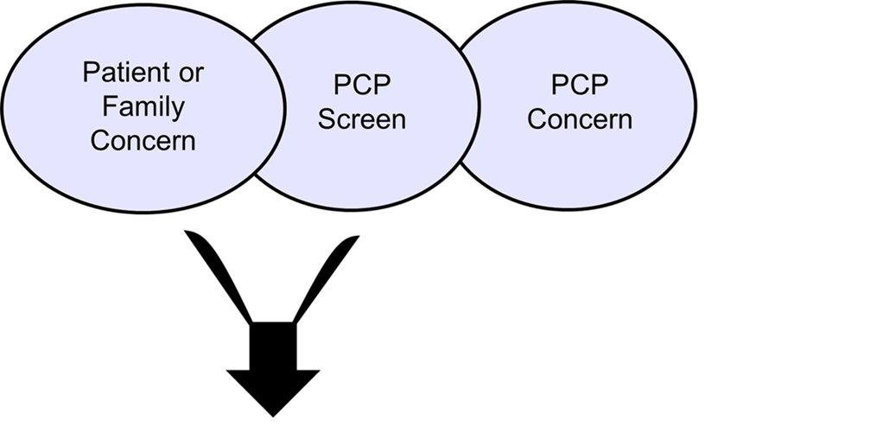

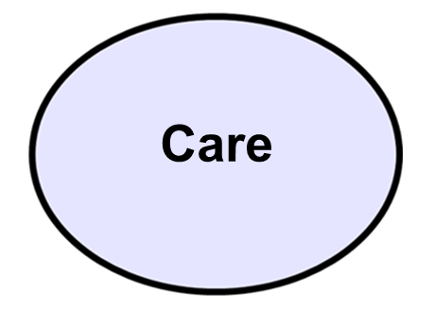

The Bottleneck
Specialists lack access.
Health systems need efficiency.
Patients want trust and convenience.
Diagnosis
Care

Slide 11
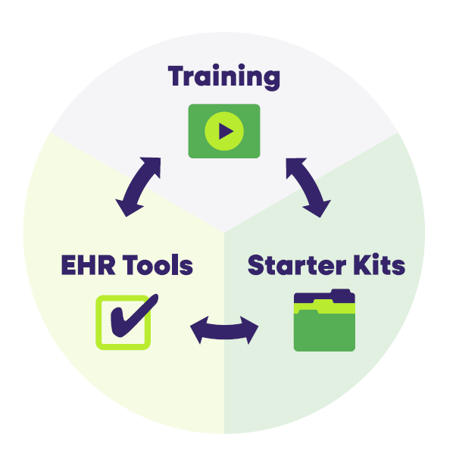
Cognition in
Primary Care
Package for quality
improvement in
primary care.

Slide 12

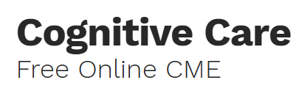
Free Recorded Training
Concise CME series (30 min x 3). Practical, efficient.
Evaluate cognition
Set plan for a newly diagnosed patient
Tips for managing dementia
www.aafp.org/cme/all/neurology/cognitive-care-fm-settings.html

Slide 13


PCP Comments
“Love this simple, straightforward approach.”
“This was practice changing.”

Slide 14


Three Parts of a Dedicated Visit to Evaluate/ Make a Diagnosis
Cognition Checklist Addressable causes. Factors you can fix.
Interviewing patient and a family member
Test of cognitive function (diagnostic-aid testing).

Slide 15


Cognition Checklist
  Labs B12 + thyroid.
Med list Sedating/ anticholinergic medications. Don’t forget OTCs: Tylenol PM. Oxybutynin.
Alcohol Even mild-to-moderate drinking can impair cognition once people get to age > 70.
Conditions Sleep apnea, hearing loss, depression.

Slide 16

“Cognition Checklist” for Newly Diagnosed
Disclose diagnosis
Offer specialist referral
Community resources
Brain Health Action
◻ Reduce alcohol (and drugs)
◻ Review medications
◻ Treat contributing conditions
◻ Exercise and Engagement
Watch 3-part recorded video series
(25 minutes per part)

Slide 17

Patient and Caregiver Support and Resources
Find a caregiver support program from a reliable database:
https:// bpc.caregiver.org
Notes:
The Best Programs for Caregiving is a free online directory of evidence-based support programs across the country for family and friend caregivers of individuals living with dementia.

Slide 18

Getting to YES: Motivating referrals to GUIDE
Consider offering help with diagnostic evaluation
We can make your life easier! (social worker, between visit care)
Do the work of interfacing with home health services
Patients can still stay connected to their PCP
Notes:
Alright so now you're ready to put it together
you're going to take the MoCA result and put it
together with the family input to make an assessment
for example let's say that the MoCA score is
intermediately-low say in the 18 to 25 range,
out of a possible score of 30
and let's say that the observer who's with them
IS reporting some worrisome changes
but they are still fully independent in their activities
of daily living. - that is they’re still able to dress
themselves cook and clean. That is a diagnosis
of mild cognitive impairment and we'll talk more in
a moment about what that diagnosis means

Slide 19
MCI vs Dementia
The “D” word can be hard to swallow
A complex determination: independent? vs not with ADLs
Functional scoring instruments (e.g. Lawton-Brody or FAQ) lack clear “cut-offs” for is it: MCI or is it dementia.
Still need to use some real art of medicine, to make the call
Notes:
Alright so now you're ready to put it together
you're going to take the MoCA result and put it
together with the family input to make an assessment
for example let's say that the MoCA score is
intermediately-low say in the 18 to 25 range,
out of a possible score of 30
and let's say that the observer who's with them
IS reporting some worrisome changes
but they are still fully independent in their activities
of daily living. - that is they’re still able to dress
themselves cook and clean. That is a diagnosis
of mild cognitive impairment and we'll talk more in
a moment about what that diagnosis means

Slide 20

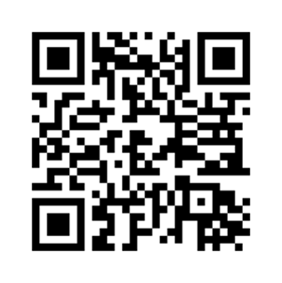

Free Online Tools
Checklist tools for the electronic health record
Workflows for cognitive evaluation, disclosing new diagnosis
Tips for talking to someone with dementia.
Free Recorded CME Training: AAFP → Cognitive Care
Cognition-PrimaryCare.org

Slide 21
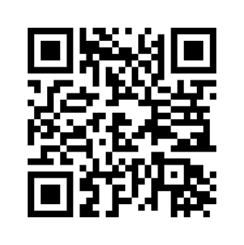
Download Free Tools
Cognition-PrimaryCare.org
cog-eval@uw.edu

Slide 22
GUIDE:
Patient outreach and provider engagement
Kyra O’Brien, MD MS
Assistant Professor of Neurology
Penn Memory Center, University of Pennsylvania

Slide 23

Dementia care at Penn Medicine
Large academic medical center with >100 primary care practices across Pennsylvania and New Jersey
  Dementia prevalence of 1-5% in patients age 65 and older
Single dementia care center (Penn Memory Center) and a handful of cognitive neurologists
  Patients face a long wait to see a memory specialist
  Geriatrics is underutilized
Patients referred to the Penn Memory Center often did not have any prior evaluation completed

Slide 24

Referrals to the Penn Memory Center
Scenario 1: Patient referred to dementia specialist with no work up
Visit 1: Specialist conducts cognitive testing and functional status assessment; evaluates for reversible causes and orders labs and brain imaging
Visit 2: Specialist reviews testing and decides if reversible cause needs to be addressed and/or if neurodegenerative evaluation is warranted → sends biomarker tests; only urgent social needs addressed
  Possible additional visit needed for follow up on response to medication change, treatment of mood disorder, sleep disturbance, etc.
Visit 3 or 4: Specialist reviews biomarker testing and delivers diagnosis, discusses social needs and refers to meet with social work team

Slide 25
Referrals to the Penn Memory Center
Scenario 2: Patient sent to dementia specialist with cognitive testing and functional activities questionnaire completed, along with reversible dementia work-up and MRI brain.
Visit 1: Specialist confirms there is cognitive impairment, orders Alzheimer’s biomarker (or other biomarker) testing and assesses for social needs
Visit 2: Specialist reviews results of testing, delivers diagnosis, discusses treatment plan, and has patient and family meet with social worker
If patients come to a dementia specialist with more information, they will receive a diagnosis and management plan faster.

Slide 26
GUIDE referrals
The same logic applies…
We can attest to a dementia diagnosis made by an outside provider, and we will do so if the patient comes to us with an adequate prior evaluation.
This allows us to spend more of the initial visit addressing other needs like care planning and social issues
At Penn Medicine, we have efforts in place to help primary care providers distinguish between mild cognitive impairment and early vs later stage dementia, to improve appropriate referrals for GUIDE and amyloid targeting therapy
At the very least, goal is for patients to be sent with cognitive impairment confirmed

Slide 27
Capability &
Opportunity
Primary care providers can play a huge role in detection of cognitive impairment, but need support to achieve this without increasing their workload
Education
Value of a cognitive impairment diagnosis
Value of (early) detection
Benefit of social work support and care planning
How to detect and stage cognitive impairment (Cognition in Primary Care program)
How to integrate detection into existing workflows (e.g., Medicare Annual Wellness visit)
Support
Conducting cognitive testing: digital cognitive assessments, EHR-integrated clinical decision supports
Interpreting cognitive testing: interprofessional consults

Slide 28
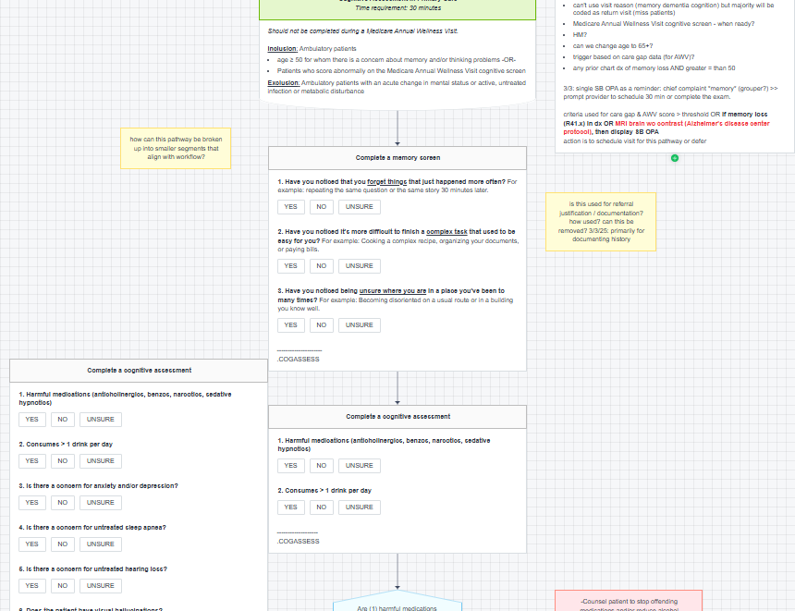
Cognitive Assessment
Penn Pathway
Cognitive history questions answered in pathway
Link to flowsheets for cognitive and functional testing
  Score interpretation
Lab and imaging orders
Specialist referral guidance
Note creation

Slide 29

Interprofessional consults (eConsults)
Planning to launch in December 2025/January 2026
For issues that can be handled within 5-10 minutes
  Cognitive test interpretation
  Imaging interpretation
  Appropriate next steps in diagnosis
  Appropriateness for amyloid targeting therapy
  Appropriateness for GUIDE
Goals:
Improve communication between neurology and primary care
Improve patient triage
Improve care efficiency

Slide 30

Motivation: Expedited referrals
Using fellow and nurse practitioner visit slots to see patients with appropriate work-up
  MRI, TSH, B12, cognitive testing
  Criteria provided within neurology consult order
Currently in use for amyloid targeting therapy program
Will use similar model for consults to GUIDE program
Expedited referrals seen within 4-8 weeks (as opposed to 9-12 months)

Slide 31
Motivation: Value of dementia detection
For patients and caregivers
Access to medications
Access to social supports
Future planning
Lifestyle intervention
For primary care providers
Support in managing dementia-related symptoms
Kept in the loop about management changes
May help with management of other comorbidities (e.g., better med adherence)
Value-based care benefits

Slide 32
Patient outreach
E-mail blasts to those subscribed to the Penn Memory Center newsletter
Attendance at community health fairs, other local events
  Meet patients and caregivers where they are
  Can also connect with potential partners for respite, caregiver supports, etc.
Plan to distribute informational flyers in Penn Medicine primary care practices where providers are using our cognitive impairment detection tools
Future state: Use Epic bulk messaging to send information about GUIDE to patients via MyChart

Slide 33
Summary
We use direct outreach to primary care providers and to patients and caregivers for GUIDE recruitment
High quality referrals can expedite care and open access for other patients
Primary care providers need the education and tools to be able to detect cognitive impairment and triage patients
Dementia specialists need to develop relationships with referring providers and be more accessible
Dementia specialists need to create avenues to expedite access to care

Slide 34
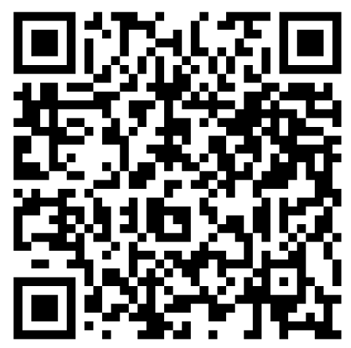
The National Dementia Care Collaborative invites you to our
2025 Autumn Summit!
RESERVE YOUR SPOT TODAY!
Virtual Forum
Tuesday, Oct 28, 2025, at 3:00 PM ET
Featuring speakers from the CMS Innovation Center,
this session will dive into new GUIDE data, share
success strategies and answer your top questions.
Screen. Share. Connect.
Tuesday, Nov 11, 2025, at 5:00 PM ET
Boston, MA (pre-GSA)
Join us for a “Taking Care” documentary watch party,
expert panel, and interactive sessions spotlighting
real-world dementia care solutions. Followed by a networking event at 7:00 PM ET.
Notes:
Insert Registration Link

Slide 35
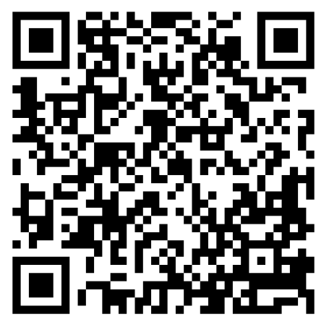
Please complete the webinar evaluation
Thank you for attending!
Notes:
https://edc.co1.qualtrics.com/jfe/form/SV_dgVqyofIHoKXe2a
Thank you for attending. The next webinar in the series will take place in March and will be focused on solutions to respite care contracting. Sign up for the wait list to be notified when registration opens! If you want to reach out to us directly, please email NDCC@edc.org.
altrics.com/jfe/form/SV_24f0mjK6mw4GEyG

